Slide 1


Bugs Framework
(Review)
11 Jan 2021

Slide 2
Today’s
Agenda
Defining Quality
Regression Pass/Fail Trendline (Last 50 releases)
Feature vs Bugs (Last 2 Months)
Review: Existing Bugs Framework
Discuss: Level of support & allowance for bug fixes

Slide 3
Defining
Quality
Correctness
Does the software behave as it was intended to?
Performance
Is the app fast enough?
Reliability
Does the app reliably accomplish its purpose?
Craft
Do all the tiny details add up to create a genuinely polished experience?

Slide 4
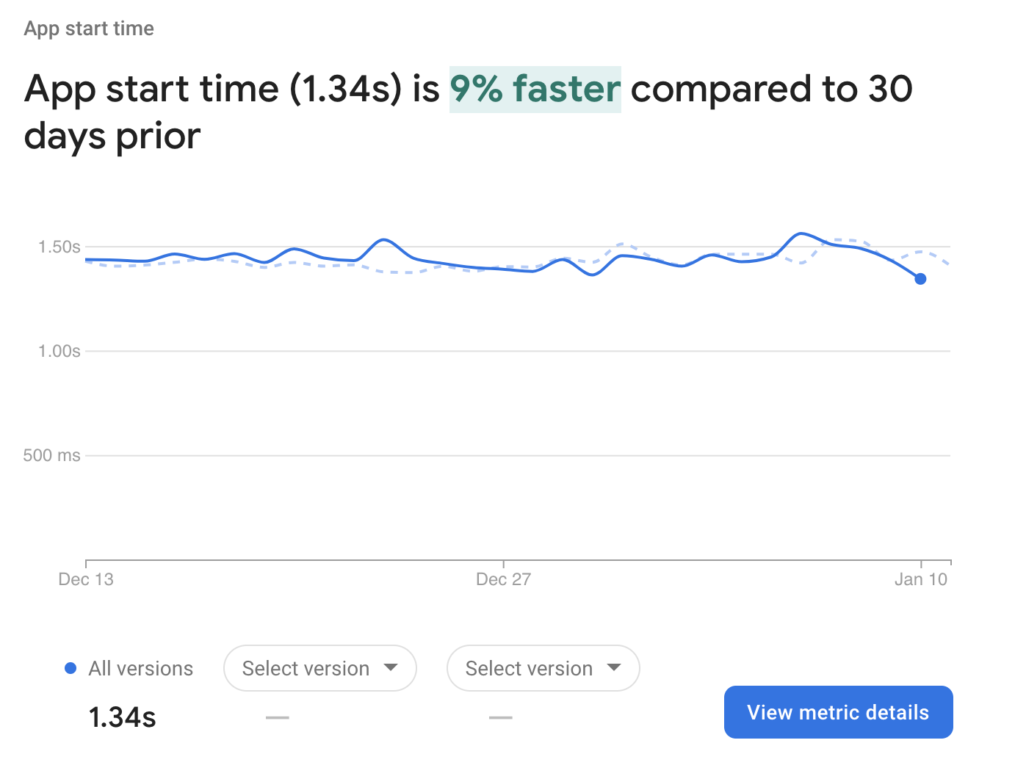
Performance

Slide 5
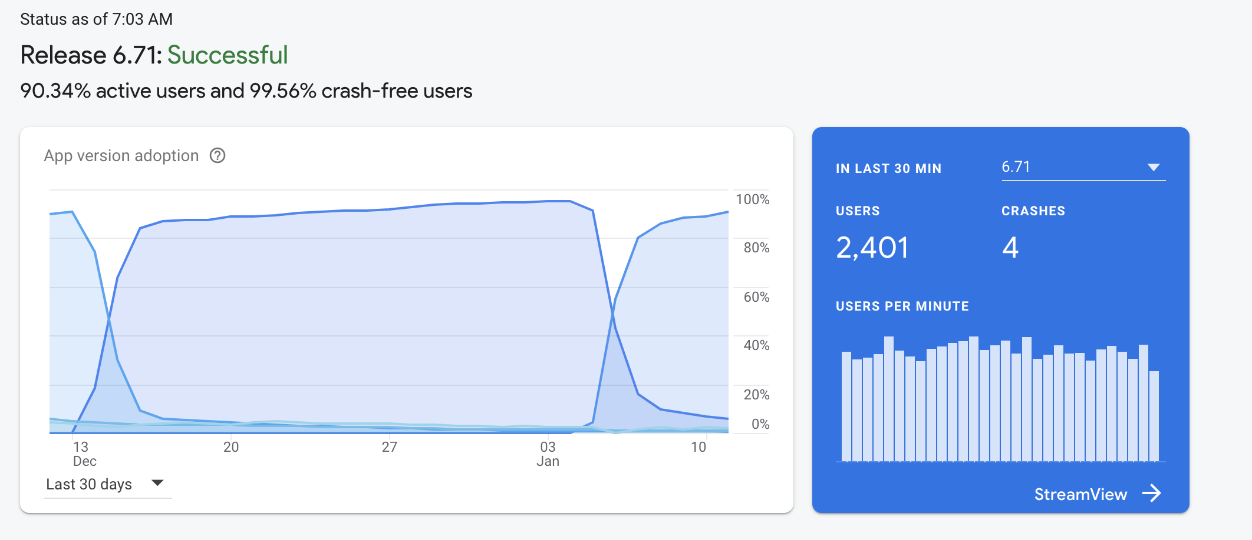
Reliability
* Note: Missing dSYM file

Slide 6
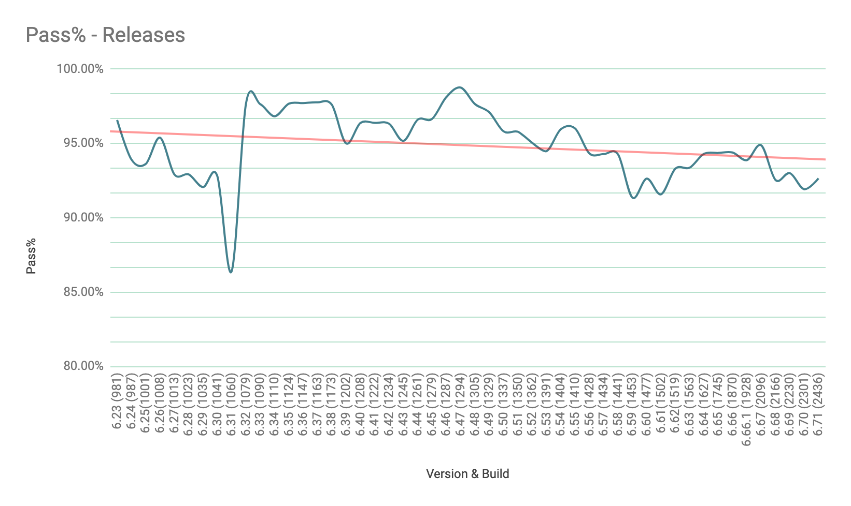
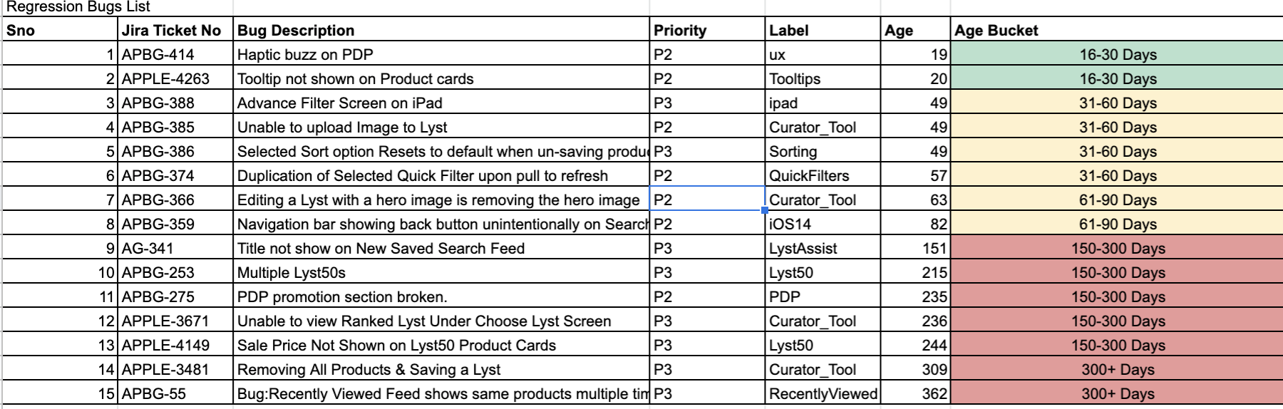
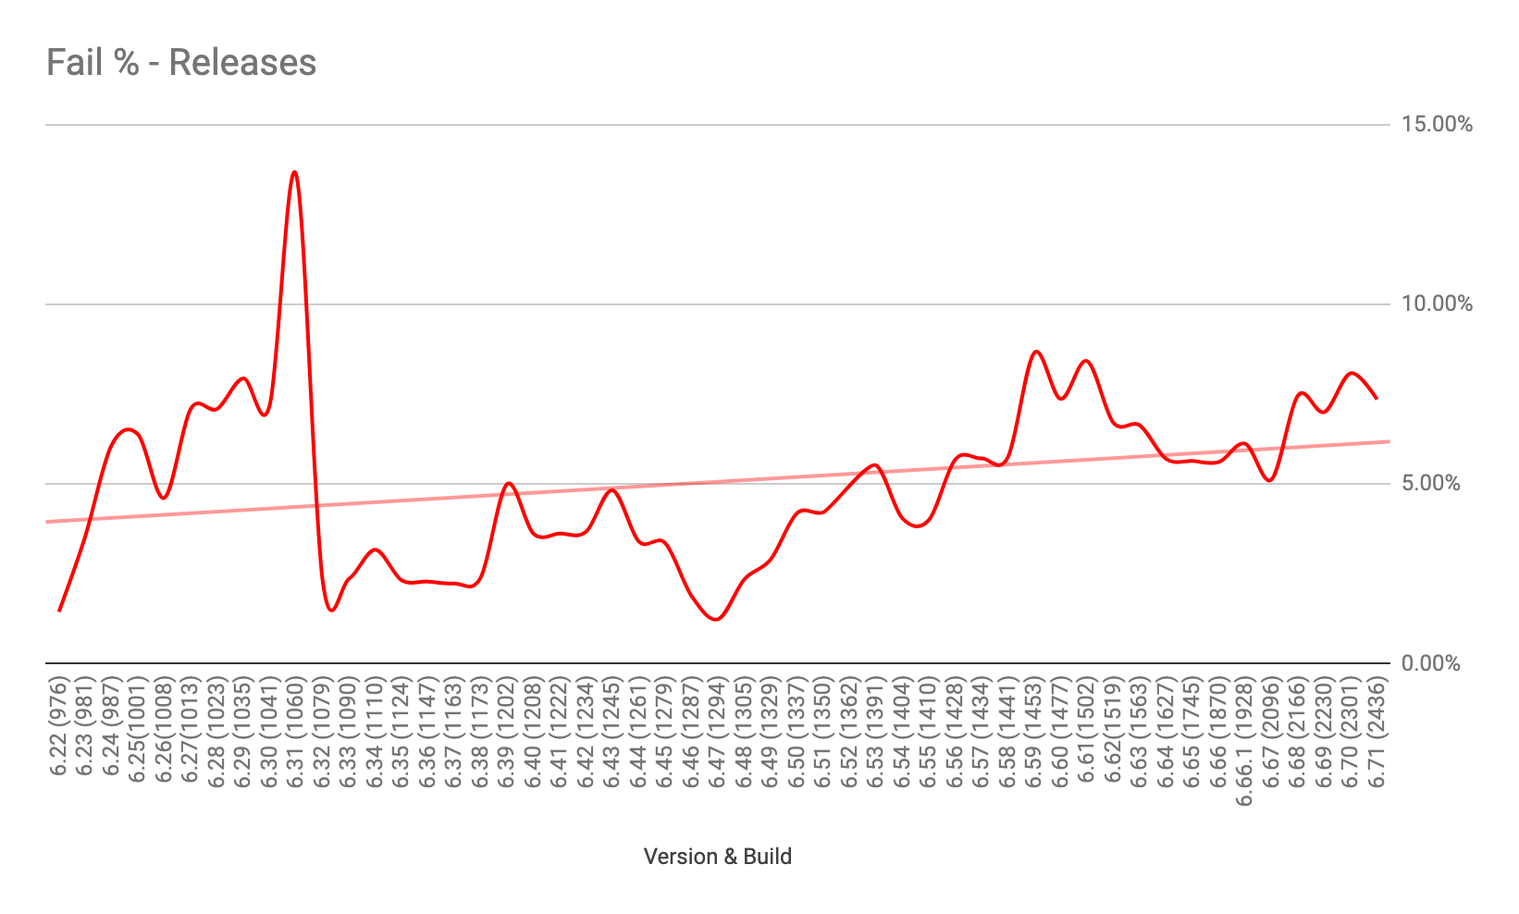
Regression: Pass/Fail Trendline
(Last 50 Releases)
98.57 to 92.65 | 1.45 to 7.35
46% Bugs are 150+ Days (1 P2)
46% Bugs are P2 (Major)

Slide 7
Features vs Bugs
(Last 2 months)
Release Date | Jira Ticket | Feature Name | Bugs Reported | Bugs Fixed | Pending | Notes
02 Nov 2020 | APPG-196 | Price Check -Experiment 1- PDP no sale no merges | 0 | 0 | 0
06 Nov 2020 | APPG-49 | Financial Incentive | 5 | 5 | 0
17 Nov 2020 | AG-391 | New colour palette | 1 | 0 | 1 | iPad Filter Screen
17 Nov 2020 | APPG-215 | Experiment 2 - PDP yes merges no discounts | 4 | 4 | 0
17 Nov 2020 | APPG-120 | Improve settings for push notifications | 2 | 2 | 0
24 Nov 2020 | APPG-217 | Price Checker 4a - with discounts - unmerged products | 0 | 0 | 0
05 Jan 2021 | APPG-245 | Build Onboarding Experiment 1a (PDP Overlay) | 1 | 1 | 0
05 Jan 2021 | AG-418 | Bring Back Search Landing Page | 1 | 1 | 0
05 Jan 2021 | APPLE-4183 | Tooltips | 5 | 3 | 2 | - Tooltip not shown on 3rd Product card - SHOWMORE tooltip not shown on Hero Image
05 Jan 2021 | AG-432 | Save for Later CTA on PDP | 1 | 0 | 1 | Haptic buzz on PDP
05 Jan 2021 | APPLE-4256 | Flexible carousel | 2 | 0 | 0

Slide 8
Bugs Framework
Priority Types:
P0: Outage
P1: Critical
P2: Default
P3: Nice-to-have
P4: Informational only
SLAs
P0: Drop everything and fix immediately
P1: Fix within Current /Next Sprint
P2: ??
P3: ??
P4: ??

Slide 9
Level of Support & Allowance for Bug Fixes

